Slide 1
Irrigation Demand
in East Africa
Challenge #2:
Team Cwa: Luke Fraser-Leach, Athena Lorenzen, Lucas Prates, and Nicole Stochmal

Slide 2
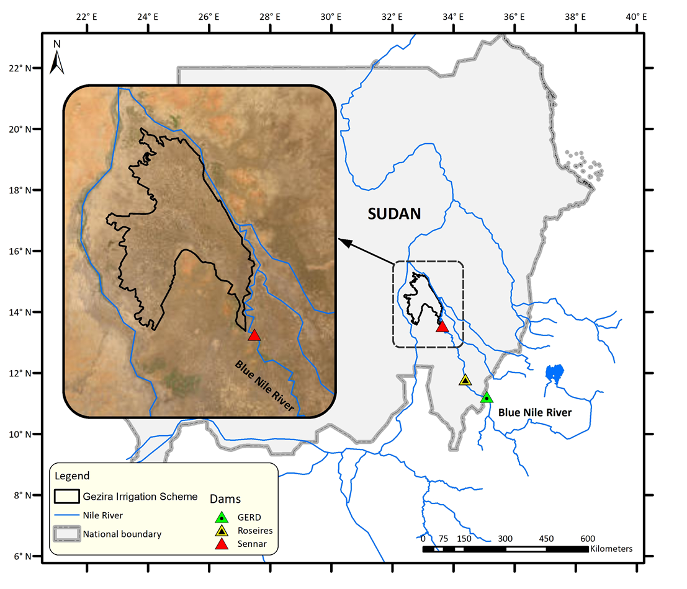
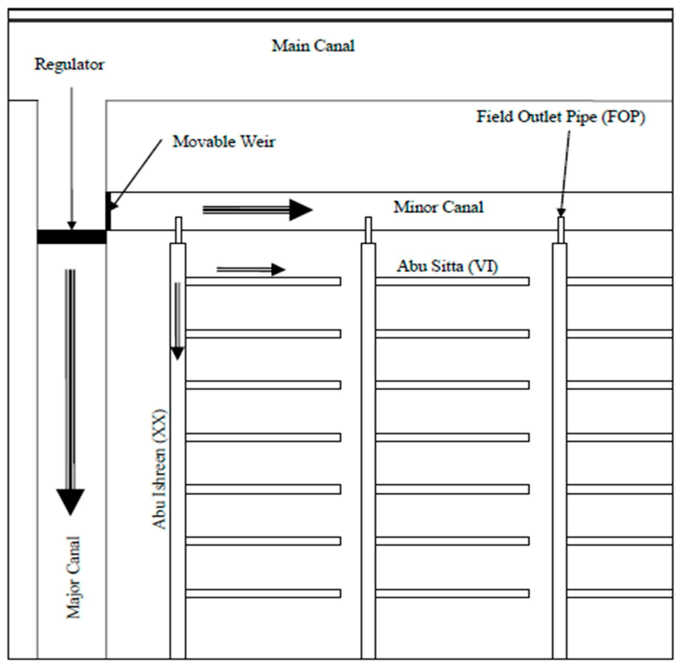
How might climate change affect supplementary irrigation in the Gezira Irrigation Scheme?

Slide 3
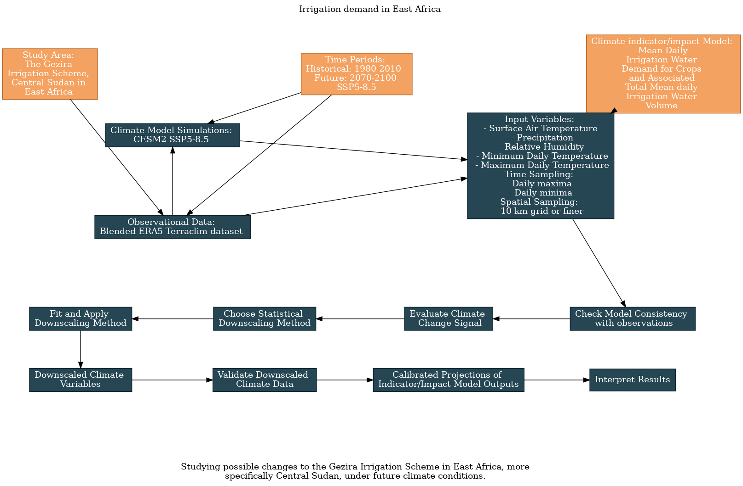
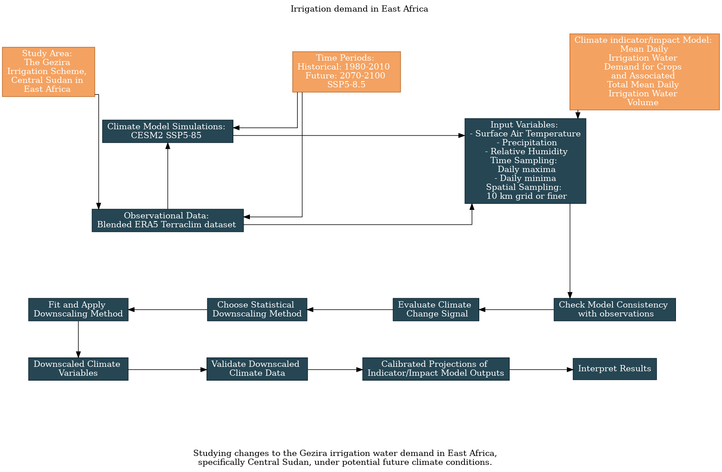
UTCDW Flowchart

Slide 4
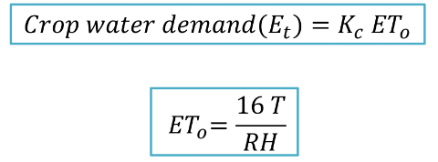
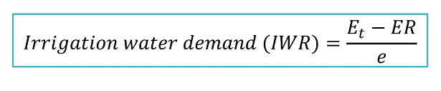
Methods
Simplified Shendel Equation to get crop water demand (mm/day)
Crops: Wheat, Sorghum, Groundnuts, Cotton
Fields:
Surface air temperature (Celcius)
Relative Humidity (percentage)
Precipitation (mm/day)
OBS: blended TerraClim + ERA5
Model: CESM (ssp370 1970-2100 vs hist 1980-2010)
Do double bias corrected constructed analogues on temperature and precipitation. DQM then QDM
Assume constant relative humidity

Slide 5
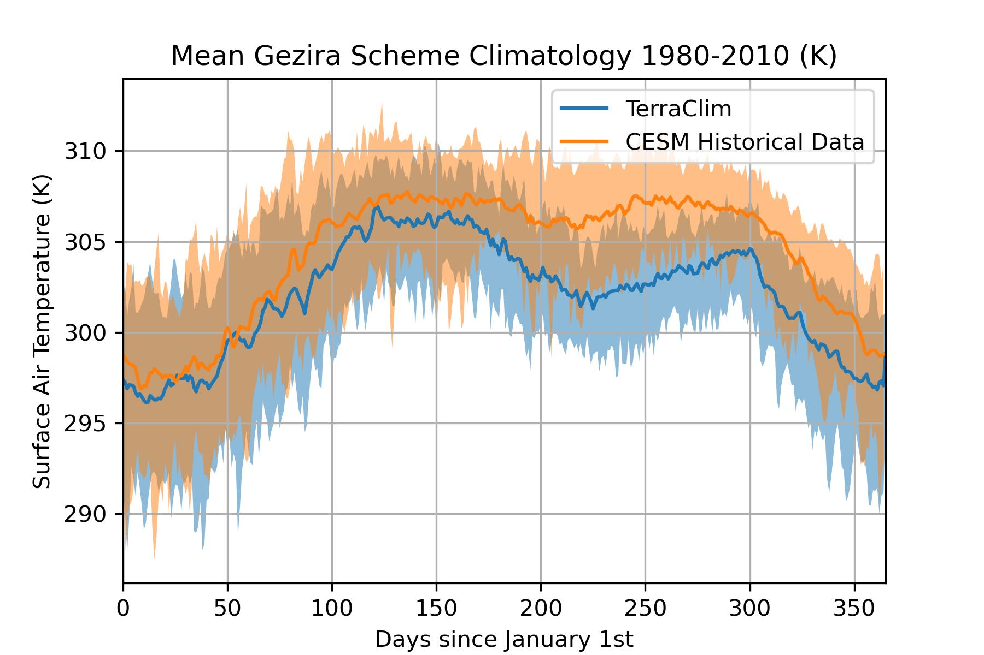
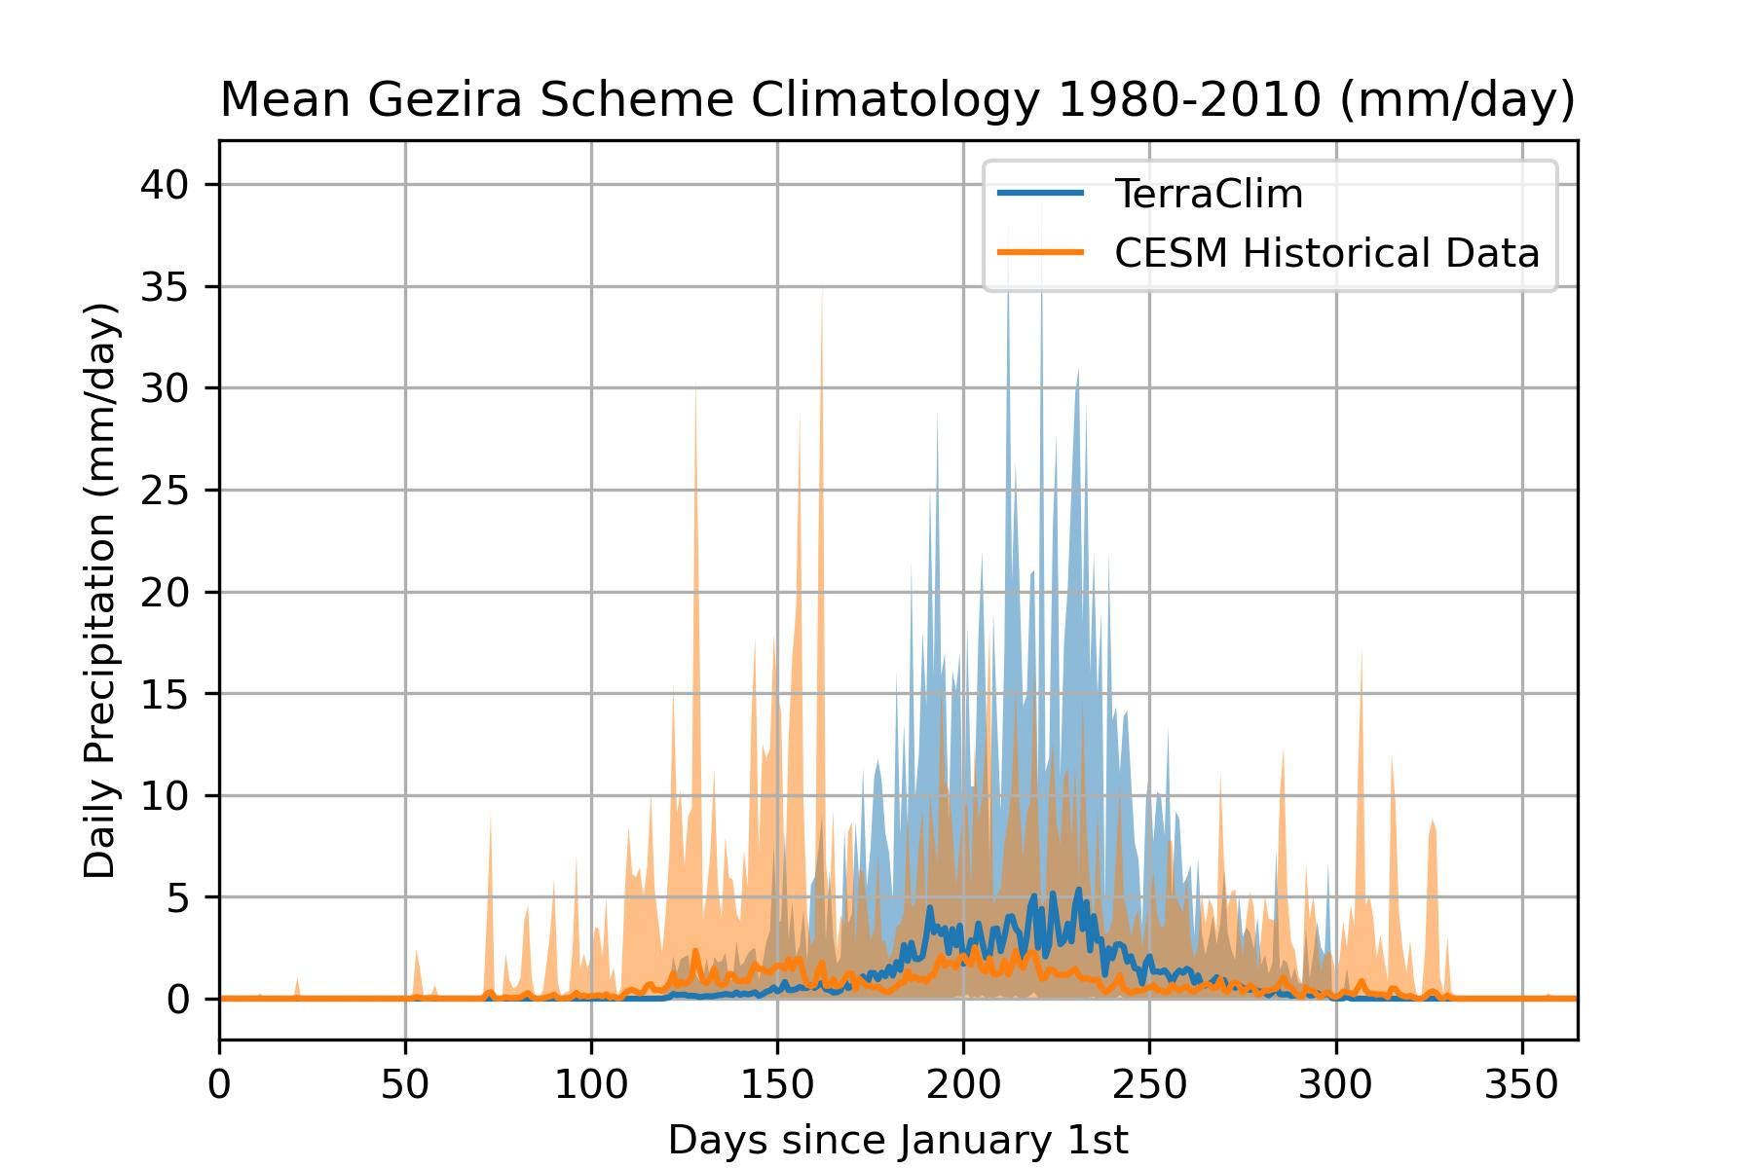
First Pass Analysis

Slide 6
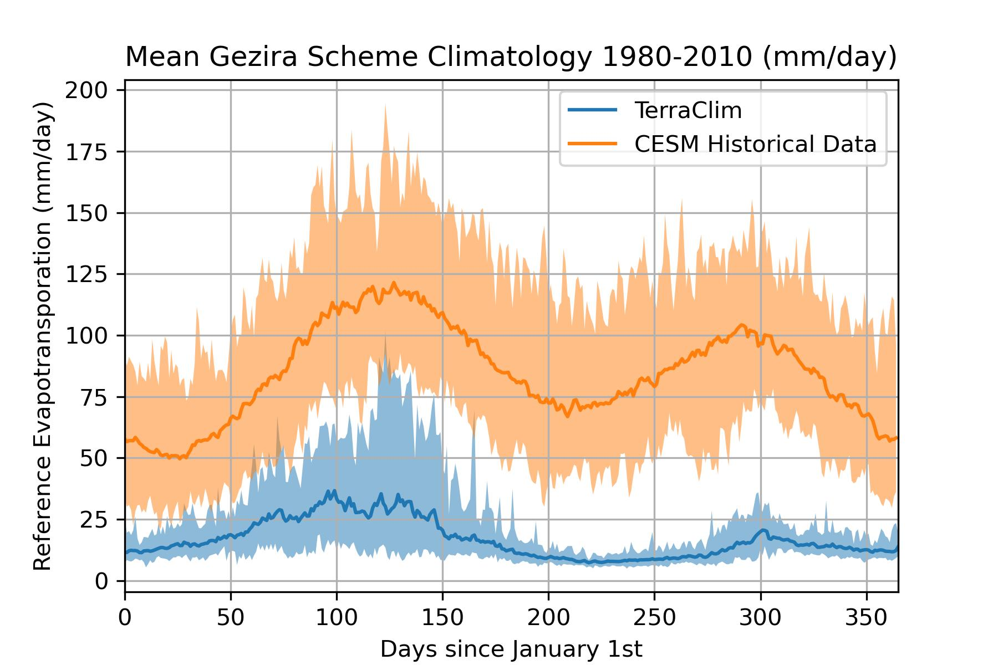
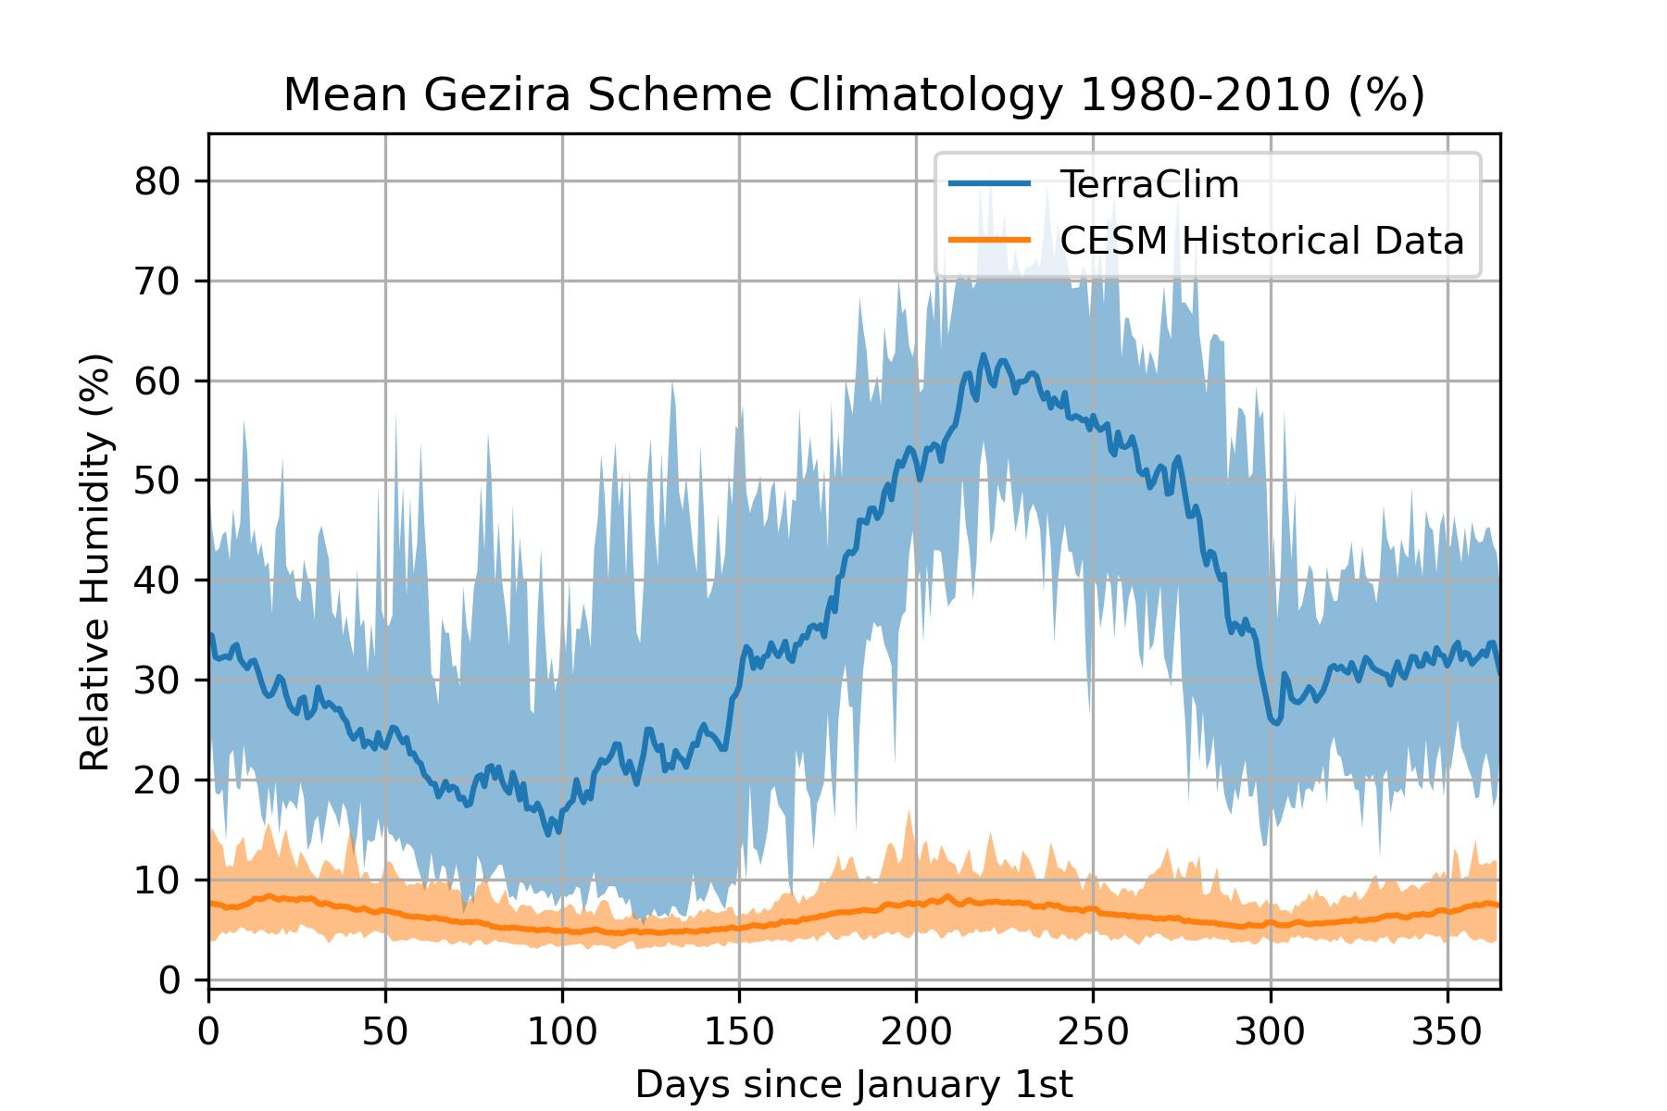
First Pass Analysis Continued

Slide 7
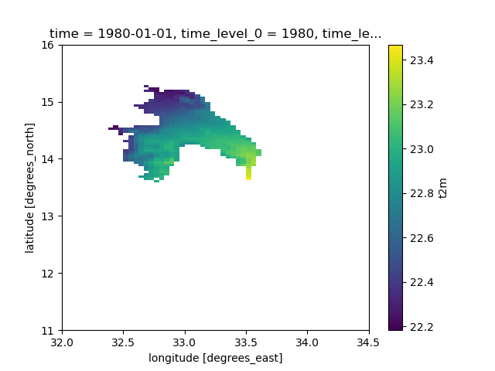
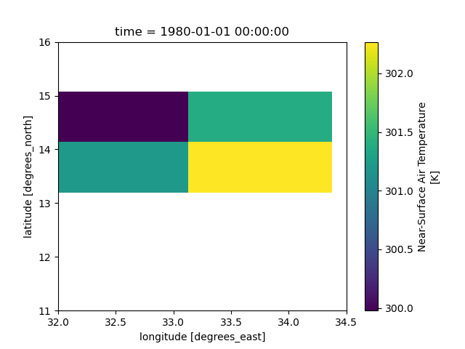
First Pass Analysis Continued
Left: TerraClim resolution. Right: CESM resolution.

Slide 8
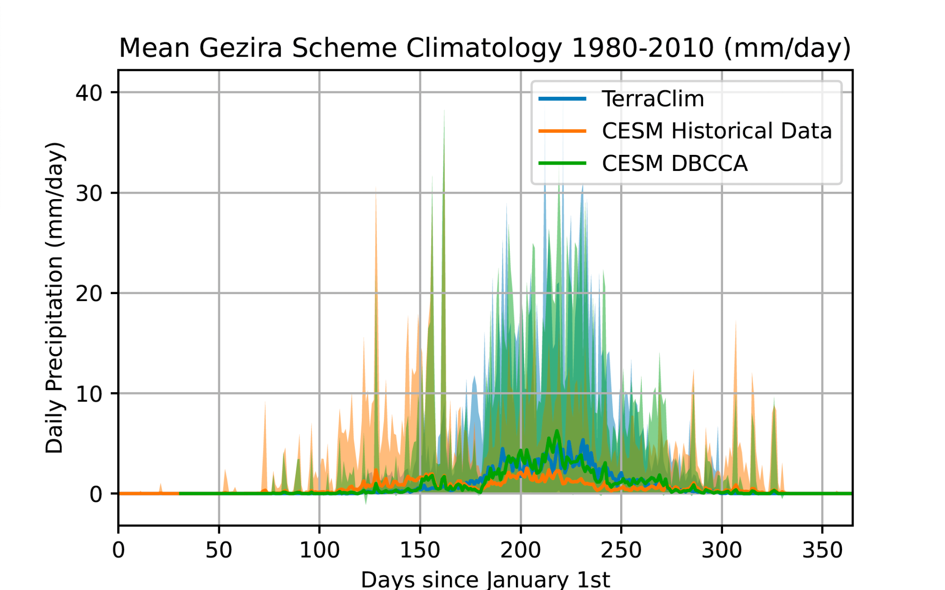
Historical Downscaling and Bias Correction

Slide 9
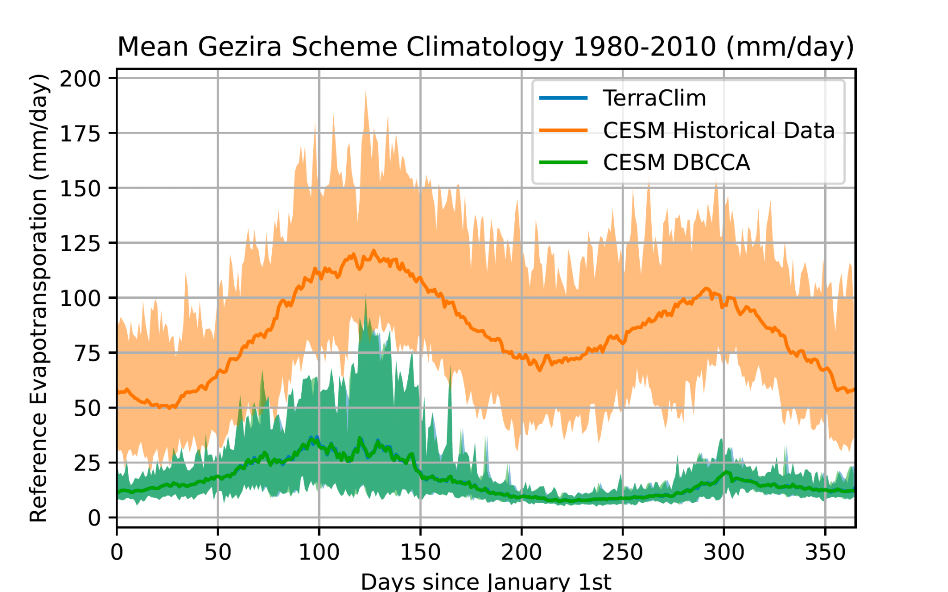
Historical Downscaling and Bias Correction

Slide 10
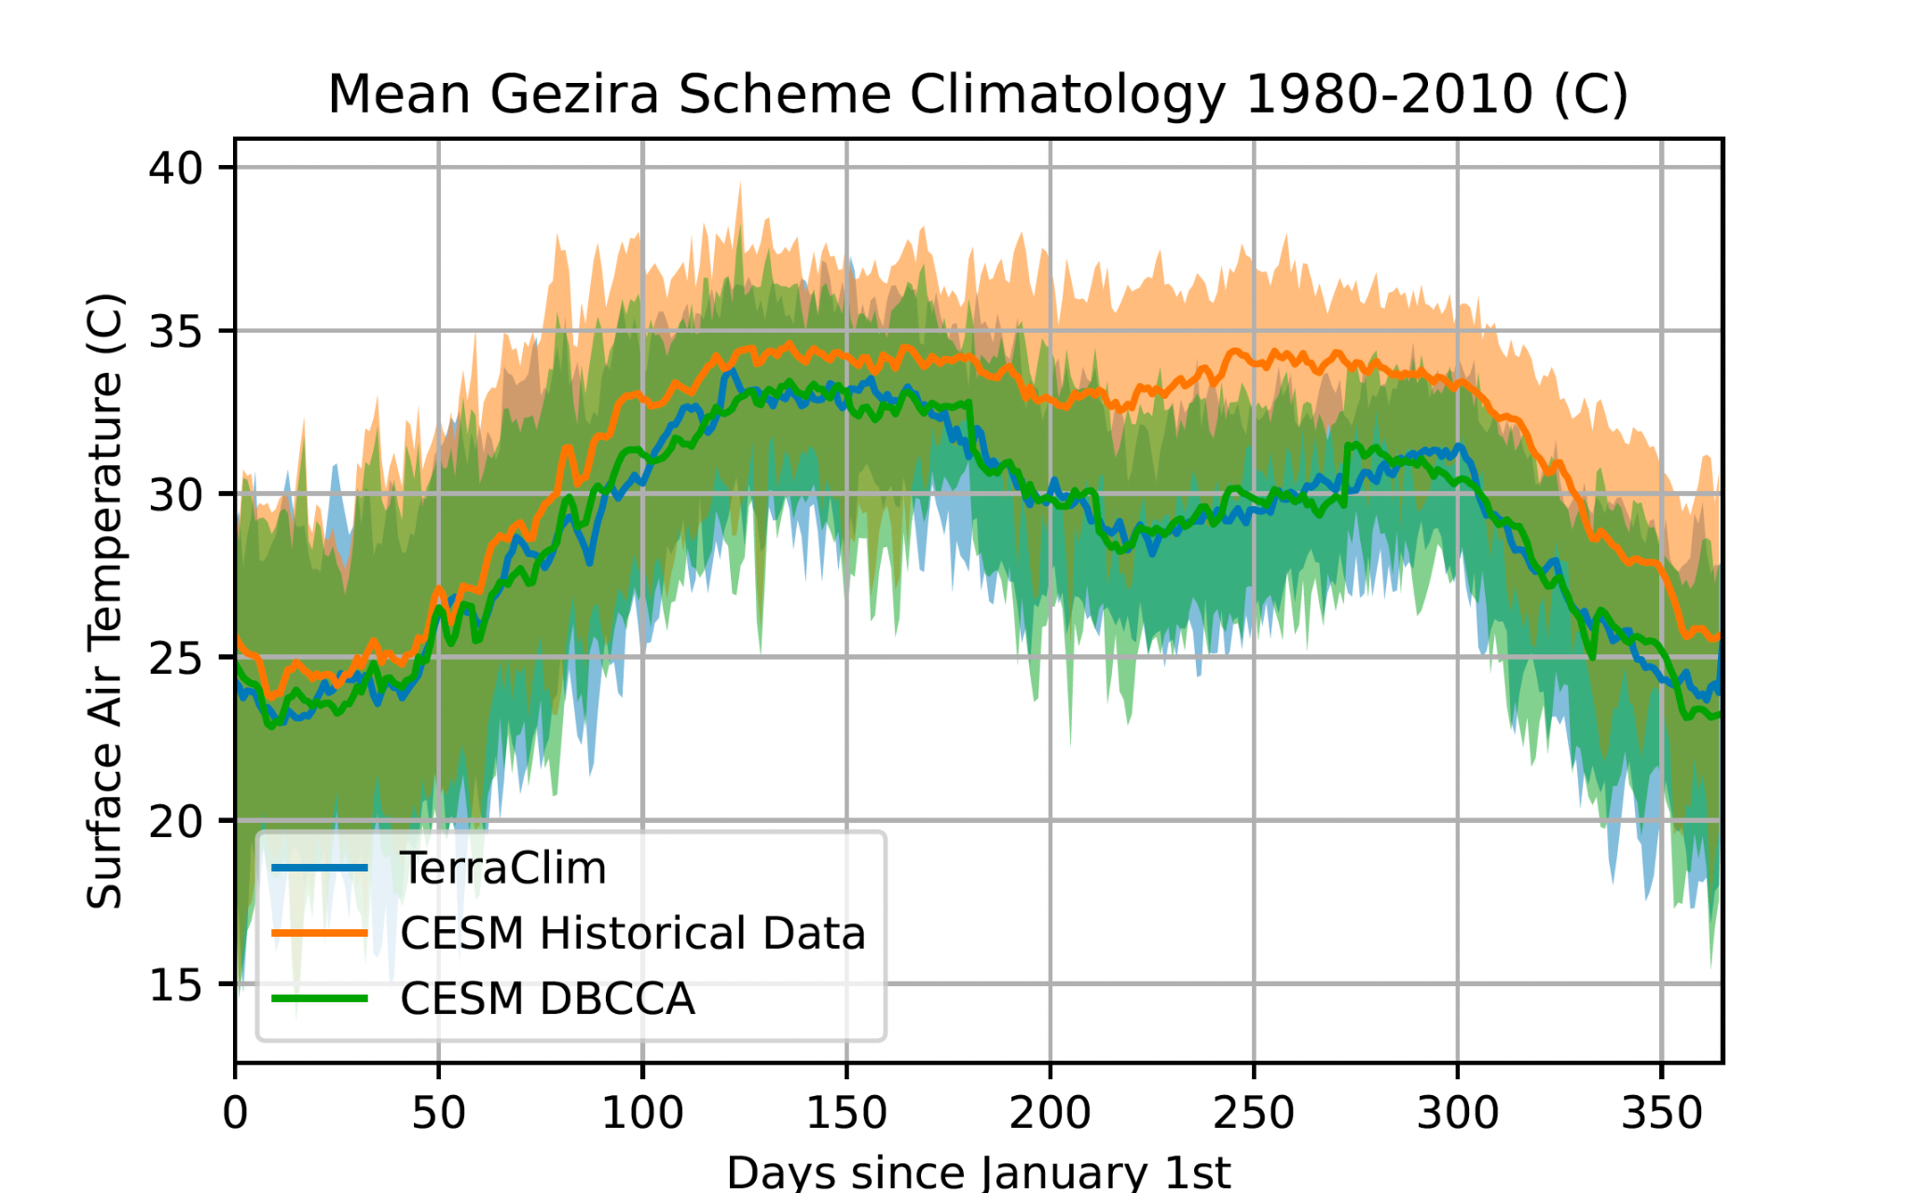
Historical Downscaling and Bias Correction

Slide 11
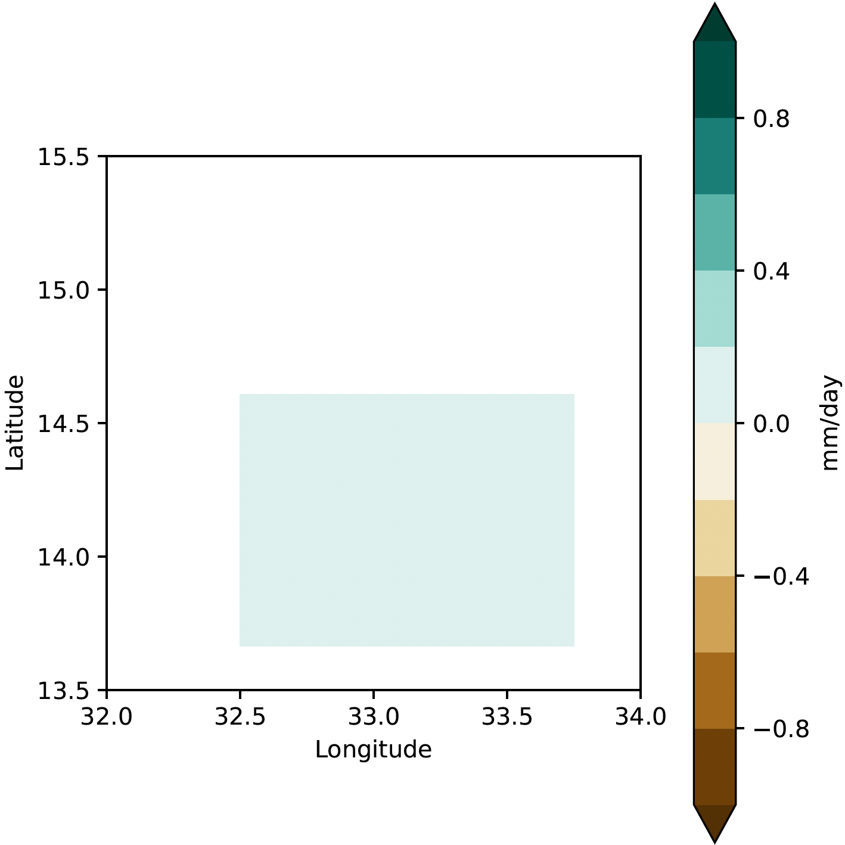
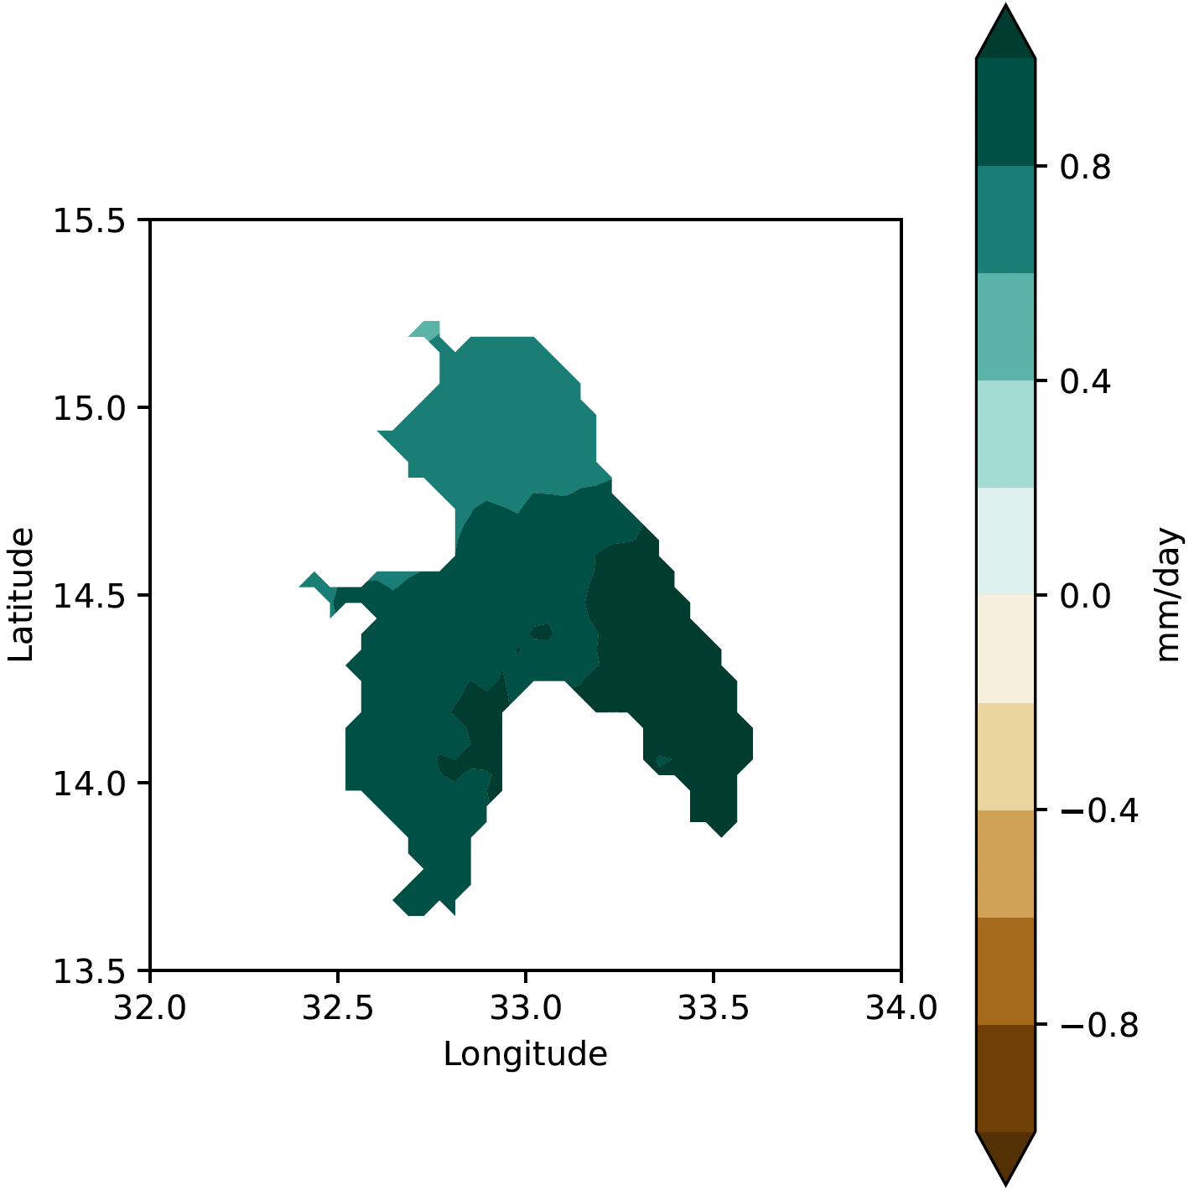
Projections: SSP370 2070-2010
Coarse
Downscaled

Slide 12
Results
Historical Mean Daily Crop Evapotranspiration (ETo): 16.9 mm/day
Future Mean Daily Crop Evapotranspiration (ETo): 19.3 mm/day
Historical Mean Daily Rainfall: 0.8 mm/day
Future Mean Daily Rainfall: 0.9 mm/day
Crop | Historical Mean Daily Crop Water Demand (mm/day) | Future Mean Daily Crop Water Demand (mm/day) | Historical Irrigation Water Demand (mm/day) | Future Irrigation Water Demand (mm/day) | Historical Mean Daily Irrigation Water Volume (billions of liters) | Future Mean Daily Irrigation Water Volume (billions of liters)
Sorghum | 7.4 | 8.4 | 12.0 | 13.6 | 33 | 38
Wheat | 5.0 | 5.7 | 7.8 | 8.9 | 23 | 26
Groundnuts | 7.0 | 7.9 | 11.2 | 12.6 | 13 | 14
Cotton | 9.5 | 10.8 | 15.7 | 17.8 | 11 | 33

Slide 13
+50% population
$10.5 billion USD
∼18 million ppl
Labor share of agriculture in Sudan (World Bank Group, 2020)
Contribution of agriculture to Sudan GDP (World Bank Group, 2022), (O’Neill, 2024)
Current face acute food insecurity (World Food Programme, 2024)

Slide 14
Propositions to Adapt
New crop distributions:
Replace crops to those with lower water demands and higher optimal temperature ranges
Wheat to sorghum
Crop | Current Distribution of land | Ideal Temp Range | Historical Mean Daily Crop Water Demand (mm/day) | Future Mean Daily Crop Water Demand (mm/day)
Sorghum | 37% | 25-27°C | 7.4 | 8.4
Wheat | 39% | 21-24°C | 5.0 | 5.7
Groundnuts | 15% | 27-30°C | 7.0 | 7.9
Cotton | 9% | 25-28°C | 9.5 | 10.8

Slide 15
Propositions to Adapt
Net Zero
-8 trillion L/yr
+5 trillion L/yr
28 trillion L/yr
Projected Average Annual Irrigation Water Demand (IWD) for Sprinkler System (65% efficiency)
Projected Average Annual Irrigation Water Demand (IWD) for Drip System (90% efficiency)
Projected Increase in Average Annual Irrigation Water Demand (IWD)
Average Historical Annual Irrigation Water Demand (IWD)
Invest in modern irrigation systems:
Cost of altering to new systems is less than restoration of the current system (International Food Policy Research Institute, 2008)
Sprinkler and drip irrigation systems are most efficient: 65-75% and 90% respectively (University of Rhode Island, 2024)
Comparison of different systems with onions in Sudan (International Atomic Energy Agency, 2016)

Slide 16
Thanks!
Do you have any questions?

Slide 17
Reference List
https://www.researchgate.net/publication/372229194_Calibration_and_Verification_of_the_Hydraulic_Model_for_Blue_Nile_River_from_Roseires_Dam_to_Khartoum_City
https://documents1.worldbank.org/curated/en/731741593616746051/pdf/Sudan-Agriculture-Value-Chain-Analysis.pdf
https://www.wfp.org/countries/sudan
https://data.worldbank.org/indicator/NY.GDP.MKTP.CD?locations=IR
https://www.statista.com/statistics/727246/share-of-economic-sectors-in-the-gdp-in-sudan/#:~:text=This%20statistic%20shows%20the%20share,sector%20contributed%20about%206.45%20percent.
https://www.iaea.org/newscenter/news/improving-sudans-vegetable-production-with-small-scale-irrigation-technologies
https://www.researchgate.net/publication/284156239_Feasibility_of_developing_a_sprinkler_irrigation_system_in_the_Northern_State_of_Sudan
https://www.iaea.org/newscenter/news/improving-sudans-vegetable-production-with-small-scale-irrigation-technologies
https://web.uri.edu/safewater/protecting-water-quality-at-home/sustainable-landscaping/drip-irrigation/#:~:text=Unlike%20other%20forms%20of%20irrigation,it%20reduces%20runoff%20and%20evaporation.

